Slide 1
Web Services Platform Architecture (WSPA)
Service-Oriented Software Engineering
Software Institute
Nanjing University
Bei Jia

Slide 2
Web Services Platform Architecture
A Web Services platform is a set of tools for invoking and deploying Web Services using a particular programming language
The platform has server-side components and client-side components
  The server-side components are usually packaged within some type of container (e.g., a Java EE application server or a servlet engine)
  The client-side components are usually packaged as tools for accessing (Java) interface instances that are bound to Web Services.
Any Web Services platform has to provide three core subsystems: Invocation subsystem, Serialization subsystem, and Deployment subsystem

Slide 3
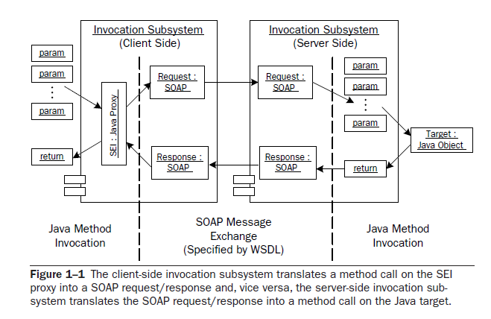
Invocation Subsystem

Slide 4
Server-Side Invocation
Receiving a SOAP message from a transport (e.g., from HTTP)
Invoking handlers that preprocess the message (e.g., to persist the message for reliability purposes, or process SOAP headers).
Determining the message’s target service (which WSDL operation to invoke)
Dispatching, determining which Java class/method to invoke (Java target)
Handing off the SOAP message to the Serialization subsystem to deserialize it into Java objects that can be passed to the Java target as parameters
Invoking the Java target and getting the Java object
Handing off the returned object to the Serialization subsystem to serialize it into an XML element conformant with the return message specified by the target WSDL operation
Wrapping the returned XML element as a SOAP message response conforming to the target WSDL operation
Handing the SOAP response back to the transport for delivery
At each stage, when an exception occurs, the invocation subsystem often must package it as a SOAP fault message to be returned to the client

Slide 5
Client-Side Invocation
Creating an instance of the Web service endpoint implementing a Java interface, Service Endpoint Interface (SEI)
Handling an invocation of the SEI instance
Taking the parameters passed to the SEI and passing them to the Serialization subsystem to be serialized into XML elements that conform to the XML Schema specified by the target service’s WSDL
Based on the WSDL, wrapping the parameter elements in a SOAP message
Invoking handlers that post-process the message (e.g., to persist the message for reliability purposes, or set SOAP headers) based on QoS or other requirements
Handing off the message to the transport for delivery to the target Web service
Receiving the SOAP message response from the transport
Handing off the SOAP message to the Serialization subsystem to deserialize it into a Java object that is an instance of the class specified by the SEI’s return type
Completing the invocation of the SEI by returning the deserialized SOAP response
Exception handling is also required

Slide 6
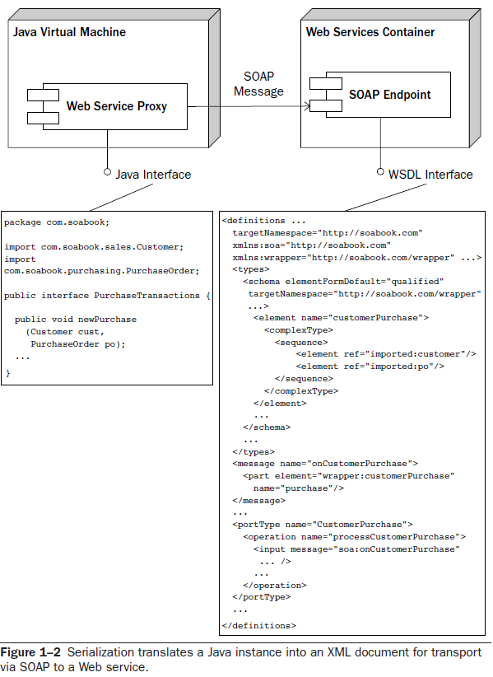
Serialization
Serialization is the process of transforming an instance of a Java class into an XML element
The inverse process, transforming an XML element into an instance of a Java class, is called deserialization
Both serialization and deserialization are simply referred as “serialization”

Slide 7
Serialization Example
Receiving the parameters from the Web service proxy
Serializing the parameter cust (an instance of com.soabook.sales.Customer) into an instance of imported:customer
Serializing the parameter po (an instance of com.soabook.purchasing.PurchaseOrder) into an instance of imported:po
Combining these two elements into an instance of wrapper:customerPurchase
Handing off the instance of wrapper:customerPurchase to the Web service proxy to be embedded in a SOAP message and sent to the SOAP endpoint

Slide 8
Serialization Subsystem
The serialization subsystem is central to the process of invoking a Web service via a Java interface
The serialization subsystem translates the parameters (passed to the interface proxy) from instances of their respective Java classes into instances of the target XML Schema (e.g., wrapper:customerPurchase in this case)
These mappings—from Java classes to target XML Schema components—are called type mappings
To accomplish this translation, the serialization engine needs a set of mapping strategies that tell it how to implement the type mappings; in other words, how to serialize the instances of the Java classes into instances of the XML Schema components

Slide 9
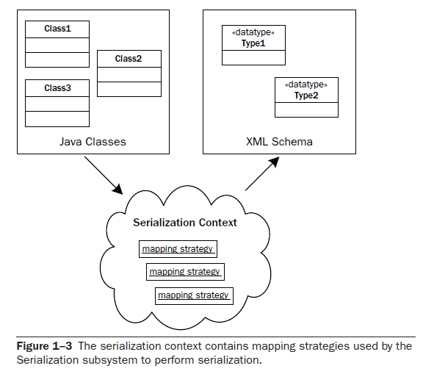
Mapping Strategy & Serialization Context
A mapping strategy associates a Java class, its target XML Schema type, and a description of a serializer (or deserializer) that can transform instances of the class to instances of the Schema type (or vice versa)
A serialization context is a set of mapping strategies that can be used by the serialization subsystem to implement the type mappings used by a particular Web service deployment
Different Web Services platforms provide different mechanisms for specifying the mapping strategies that make up a serialization context

Slide 10
Mechanisms for Implementing Type Mappings (1/2)
Standard binding
  The mappings are predefined by a standard binding of Java classes to XML Schema. Each Java class has a unique representation as an XML Schema
  JWS starts from this approach and allows customizations
  The standard binding is described by the JAXB and JAX-WS specifications
Source code annotations
  JWS uses this approach to provide customizations on top of the standard binding
  Annotations in the source code of a target Java class modify the standard binding to specify how the class maps to XML Schema components and how the WSDL description of the Web service is shaped

Slide 11
Mechanisms for Implementing Type Mappings (2/2)
Algorithmic
  The mappings are embedded in the algorithms executed by the serialization subsystem
  JAX-RPC 1.1 and Axis 1.x take this approach
Rule-based
  The mappings are specified as rules that can be created and edited independent of the serialization subsystem. The rules are interpreted by the serialization subsystem
  The Castor serialization framework also supports this approach with its mapping files mechanism
    Castor is an Open Source data binding framework for Java. It provides Java-to-XML binding, Java-to-SQL persistence, and more

Slide 12
Deployment Subsystem
The deployment subsystem supplies the tools for setting up a Java target so that it can be invoked as a Web service via SOAP messages
Its Responsibilities include
  Deploying the Java target(s), deploying a stateless session bean for an EJB container, otherwise, make each Java target’s class definition available
  Mapping WSDL operation(s) to a Java target(s), link incoming SOAP message to Java target(s)
  Defining a serialization context, which is used by Serialization Subsystem
  Publishing the WSDL
  Configuring SOAP handlers, to provide QoS pre- or post- invocation of the Java target
  Configuring an endpoint listener

Slide 13
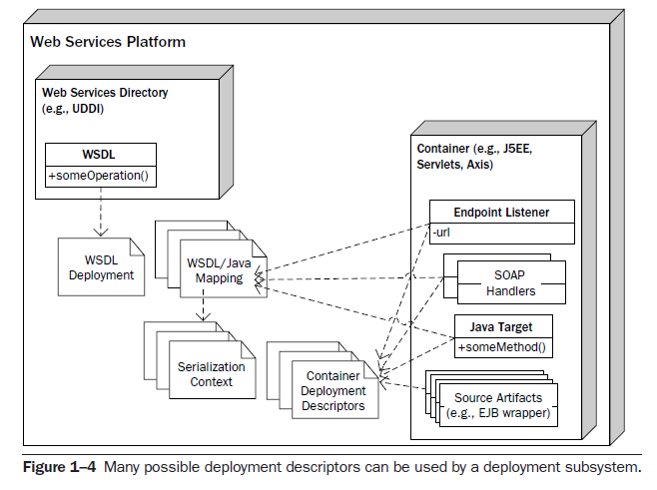
Deployment Descriptors
To handle a wide variety of situations (e.g., QoS requirements, custom Java/XML bindings, configurable endpoint URLs, etc.), the deployment descriptors quickly grow complicated and difficult to manage without visual tools
Each of the objects deployed in the container depends on container-specific deployment descriptors
The endpoint listener, SOAP handlers, and Java target may also be described in the WSDL/Java mapping descriptor
Deployed both as an object in the container and in the Web Services platform

